Slide 1
Prototype design pattern
Prototype pattern refers to creating duplicate object while keeping performance in mind.
This pattern involves implementing a prototype interface which tells to create a clone of the current object. This pattern is used when creation of object directly is costly.
For example, an object is to be created after a costly database operation. We can cache the object, returns its clone on next request and update the database as and when needed thus reducing database calls.

Slide 2
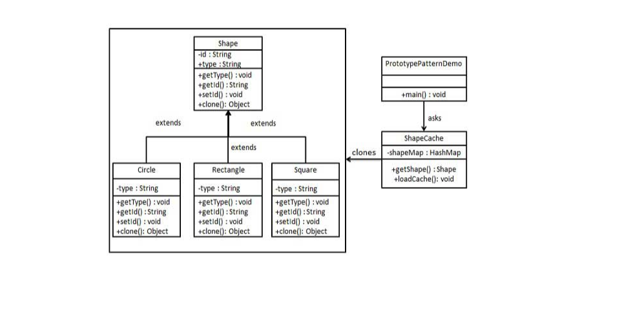

Slide 3
